Slide 1

LECTURE – 1.7
BIODIVERSITY
Biodiversity Hotspots
Threats to Biodiversity
Biodiversity conservation

Slide 2
BIODIVERSITY HOTSPOT
A biogeographic region characterized both by exceptional levels of plant endemism and by serious levels of habitat loss. - Norman Myers, 1988
Two criteria to qualify as a biodiversity hotspot
Must contain at least 0.5% or 1,500 species of endemic plants
Has to have lost at least 70% of its original habitat.
There are 34 hotspots - each with unique, endemic wildlife under threat from human activities.
These sites support nearly 60% of the world’s plant, bird, mammal, reptile, and amphibian species, with a very high share of endemic species.
Hotspots are not formally recognized or governed areas. However, the identification of an area as a biodiversity hotspot increases the likelihood of conservation investment.
The Critical Ecosystem Partnership Fund (CEPF) is an alliance among seven nongovernmental and private-sector organizations (including Conservation International).
CEPF provides grants to organizations around the world that are working to help protect biodiversity hotspots.
Biodiversity hotspots are also used by major foundations and the Global Environment Facility (GEF) to target investments in global conservation
Ref: https://www.naturepl.com/pictures/pdfs/Naturepl.com_Hotspots.pdf
https://www.biodiversitya-z.org/content/biodiversity-hotspots.pdf

Slide 3
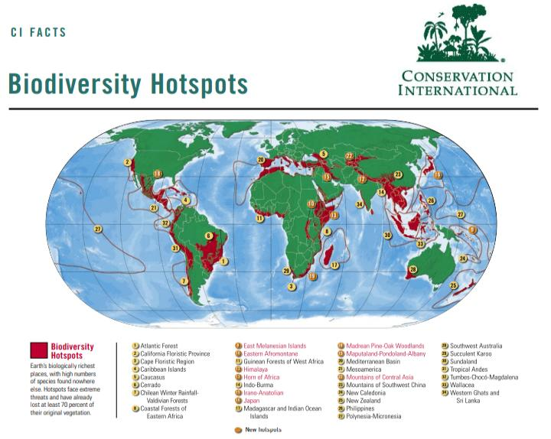
Ref: https://culter.colorado.edu/~kittel/CIHotspots_Feb05.pdf

Slide 4
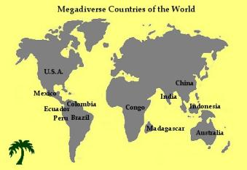
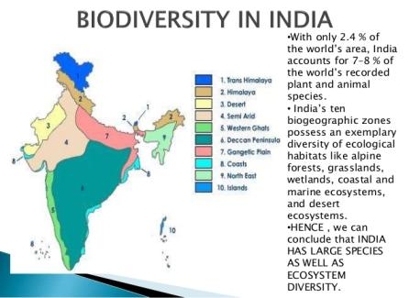
INDIA AS A MEGA DIVERSITY NATION
The large species richness and abundance are due to immense variety of climatic and altitudinal condition in country.
Less than 10% of global surface, Supporting more than 70% of the biological diversity.
Rich in endemic species that are present only in India and found no where else in the world
These vary from the humid tropical Western Ghats to the hot desert of Rajasthan, from cold desert of Ladakh and the icy mountain of Himalayas to the warm cost of peninsular India
It includes ecosystem diversity is highest in the world, which represents forest, grassland, wetland, coastal and marine and the desert ecosystems.
Ref: https://isebindia.com/09-12/10-11-3.html

Slide 5

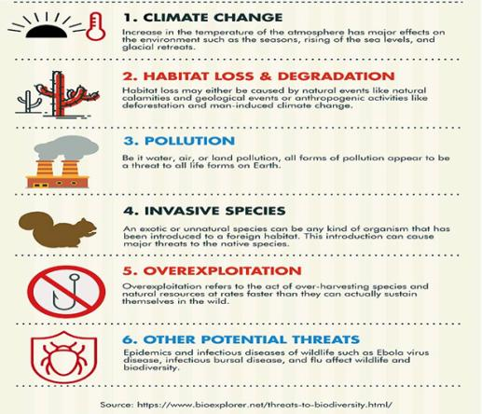
99.9% of all animals that once lived on Earth are now extinct !!!
It is predicted that we are losing 1% of existing species per decade i.e., 2 species per every hour !!!!!
Indian Cheetah, lesser Indian Rhino, Pink-headed duck, forest Owlet and Himalayan Mountain Quail are reported to have become extinct.
Extinction is the most irreversible and tragic of all environmental calamities. With each plant and animal species that disappears, a precious part of creation is callously erased.” -Michael Soule (2004), noted American conservation biologist

Slide 6
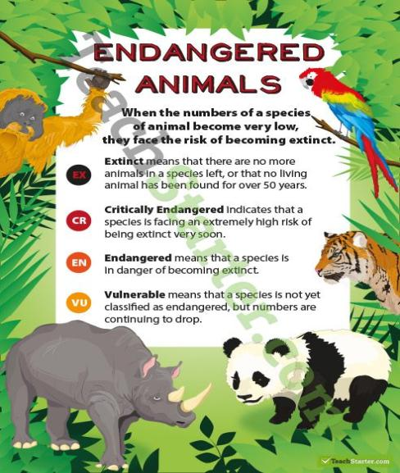
Why We Protect Them
The Endangered Species Act (ESA) is very important because it saves our native fish, plants, and other wildlife from going extinct. Once gone, they're gone forever, and there's no going back. Losing even a single species can have disastrous impacts on the rest of the ecosystem, because the effects will be felt throughout the food chain. From providing cures to deadly diseases to maintaining natural ecosystems and improving overall quality of life, the benefits of preserving threatened and endangered species are invaluable.
Ref: https://www.nwf.org/Educational-Resources/Wildlife-Guide/Understanding-Conservation/Endangered-Species

Slide 7
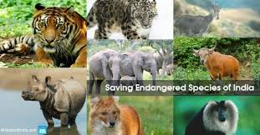
How a Species Gets Listed
When deciding whether a species should be added to the Endangered Species List, the following criteria are evaluated:
Has a large percentage of the species' vital habitat been degraded or destroyed?
Has the species been over-consumed by commercial, recreational, scientific or educational uses?
Is the species threatened by disease or predation?
Do current regulations or legislation inadequately protect the species?
Are there other man-made factors threatening the long-term survival of the species?
Ref: https://www.nwf.org/Educational-Resources/Wildlife-Guide/Understanding-Conservation/Endangered-Species

Slide 8
Endangered species Those which are in danger of extinction and whose survival is unlikely if causal factors (like few numbers, changing environmental or predation parameters) continue operation. Eg. Nepenthes sp., Vanda sp., Cycas sp.
Vulnerable category Those which are likely to move into endangered category in near future if causal factors continue operation. Eg. Podophyllum sp., Taxus sp., Cheetah, Komodo dragon
Critically endangered/ Threatened Faces an extremely high risk of extinction in the immediate future (e.g. Gharial)
Rare organisms Those which are of small world population and at present are neither endangered nor vulnerable but are at risk. Eg. Farsetia sp., Rauwolfia sp.
Threatened Species which are in one of the three categories-endangered, vulnerable and rare. Species are marked as threatened where it is known that they are endangered, vulnerable or rare but it can’t be said as to which category they exactly belong.
Endemic: An 'Endemic Species' is one that is only found in a particular region and nowhere else in the world. Examples are Many orchids, bamboo, Indian wild ass, Himalayan Tahr, Nilgiri Tahr

Slide 9
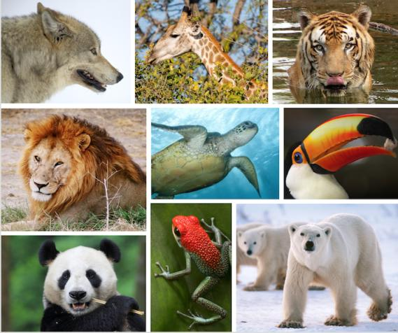
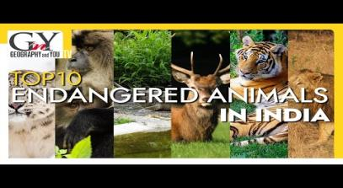
Important endangered Indian endemic species
The lion-tailed Macaque
The Asiatic Lion
The Red Panda
The black buck
The slender primate

Slide 10
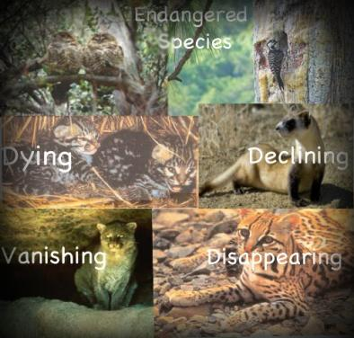
RECOGNITION OF THREAT TO INDIVIDUAL SPECIES IN THEIR WILD HABITAT IS BASED ON
1. The past and present distribution
2. Decline in the number of population in course of time
3. Abundance and quality of natural habitat
4. Biological and potential value of the species

Slide 11
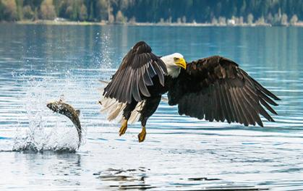
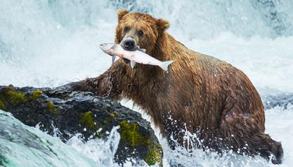
Success Stories – Case Studies
1. Bald Eagle
In the 1960s, a mere 500 bald eagles could be found soaring across America's lower 48 states.
Dangerous pesticides and chemicals, released into bald eagle habitats, thinned the shells of their eggs, killing their young.
1960s - only 400 breeding pairs of bald eagles were found.
Under ESA - bald eagle numbers have rebounded to more than 7,000 breeding pairs of bald eagles today.
Captive breeding programs, habitat protection, and a ban on DDT (a chemical compound used to kill insects) contributed to the successful recovery of this American symbol.
2. Grizzly Bear
Their populations have been reduced to a mere two percent of their former range due to a combination of excessive hunting, conversion of habitat to human uses and fragmentation of habitat caused by such things as extensive networks of logging roads.
ESA -1975 - 250 bears.
Since then, the coordinated efforts of state and federal agencies, conservation organizations and private citizens have increased this population to more than 600 bears.
Approximately 600 bears occupy habitat in Glacier National Park, Montana, Canadian border.

Slide 12
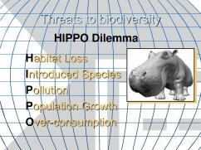
THE H.I.P.P.O. DILEMMA
There are many threats to biodiversity today. The biggest ones can be remembered by using the acronym
Habitat Loss, Invasive Species, Pollution, Population, Overharvesting.
When a particular area is converted from usable to unusable habitat.
Industrial activities, agriculture, aquaculture, mining, deforestation.
Example: Habitat fragmentation in the Amazon rainforest.
Non-native or exotic species that are not native to a particular region, and
threaten native species, which have no natural defenses against them.
New species can parasitize or predate upon residents. Example: Lantana, congress grass, Nile perch etc.
The discharge of toxic synthetic chemicals and heavy metals into the environment has a huge impact on species abundance and can lead to extinctions.
Example: Bioaccumulation, higher industrial emissions etc.
A tremendous change occurred with the industrial revolution:
whereas it had taken all of human history until around 1800 for world population to reach one billion.
The second billion was achieved in only 130 years (1930), the third billion in less than 30 years (1959), the fourth billion in 15 years (1974), and the fifth billion in only 13 years (1987). During the 20th century alone, the population in the world has grown from 1.65 billion to 6 billion.
5. This includes targeted hunting, gathering, or fishing for a particular species as well as incidental harvesting.
Example: bycatch in ocean fisheries.
https://www.thelandbetween.ca/2020/01/hippo-the-greatest-threat-to-biodiversity/

Slide 13
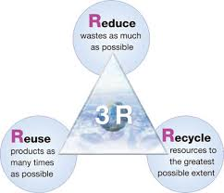

HIPPO Dilemma – Road Ahead
20% of world population consumes 80% of resources & produces 80% of waste
Consumerism & Eco-consumerism - 3 Rs
Reduce - At source, lesser chance of waste generation
Reuse - in current form without any energy to convert into new form
Recycle - energy used to transform into new usable product (Vermi-composting)
Manufacture for one-time use
Cost of manufacture (Raw material + Energy) +Waste + Waste disposal + waste management
Multiply the cost over lifespan
What is the environmental cost of disposable items?
Consumer products can become psychologically obsolete
Depletion of non-renewable resources
Poisoning & degradation of ecosystem
https://minusoneproject.wordpress.com/tag/eco-consumerism/

Slide 14
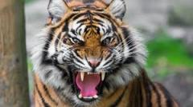
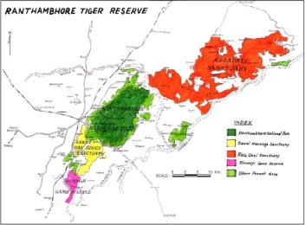
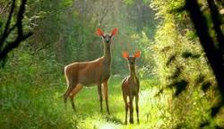
Kailadevi Sanctuary - Case Study (2009)
The Kailadevi Wildlife Sanctuary (KWS) is the northern extension of the Ranthamboree National Park and falls within the buffer zone of the Ranthamboree Tiger Reserve.
The sanctuary is located in the Karauli district of Rajasthan and falls within the Karauli and Sapotra blocks.
It has become a popular reference among environmentalists and conservationists - community-initiated forest protection committees (kulhadi bandh panchayats) operational in the area.
These forest protection committees prevent the carrying of axes into the forests, a symbol of protecting the forests.
Meena & Gujjar communities inhabited the area and initiated pastoralism (branch of agriculture concerned with the raising of livestock ) & subsistence agriculture (farming in which the farmers focus on growing enough food to feed their families )
Migrant grazers called Rabaris entered with a herd of 1,50,000 sheep, further pressurizing the sanctuary, Exploitation of timber, fuelwood & mining
The threat poised by the migrant grazers spurred the formation of the “Baragaon ki Panchayat” in 1990
Local community initiatives for conservation: Van Suraksha Samiti
Mining is now banned in the Sanctuary. The people not only protect their forests but also use their resources judiciously.
Ref: https://kalpavriksh.org/kailadevi-sanctuary/

Slide 15
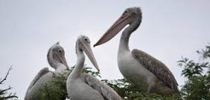
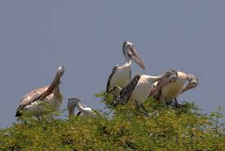
Kokkare Bellure, Karnataka - Case Study
Legend has it that the storks and pelicans have been coming to Kokkare Bellur to breed for hundreds of years. A small village about 80 kilometers from Bangalore, ‘Kokkare Bellur’ in Kannada means “the hamlet with white storks” and was situated on the banks of the river Shimsha.
The pelican, an endangered species breeds in large numbers at Kokkare Bellur
one of the ten known breeding sites in India
In Dec, Spot-billed pelicans, painted storks, ibis establish breeding colonies on tamarind trees. Local people protected bird and collected Bird droppings: Guano- natural fertilizer
Main factors for decline of pelican population
Habitat Destruction: Lack of nesting space, Conversion of land for arable crop, no breeding sites
Increase in human population, consequent pressure on remaining trees for fuel and fodder (No legislative protection can be provided).
Indiscriminate lopping of trees throughout the year, Baking of bricks (using firewood) for construction of modern dwelling units, Increasing number of tourists leading to increased predatorship by crows.
Reduction of food
Pollution of marshlands: Changeover to green revolution methods & loss of fishing grounds (feed for pelicans)
Excess growth of aquatic vegetation, Excess pesticides causing fish mortality
Hunting of pelicans
Ref: https://www.wwfindia.org/news_facts/feature_stories/kokkare_bellur_nest_in_peace/

Slide 16
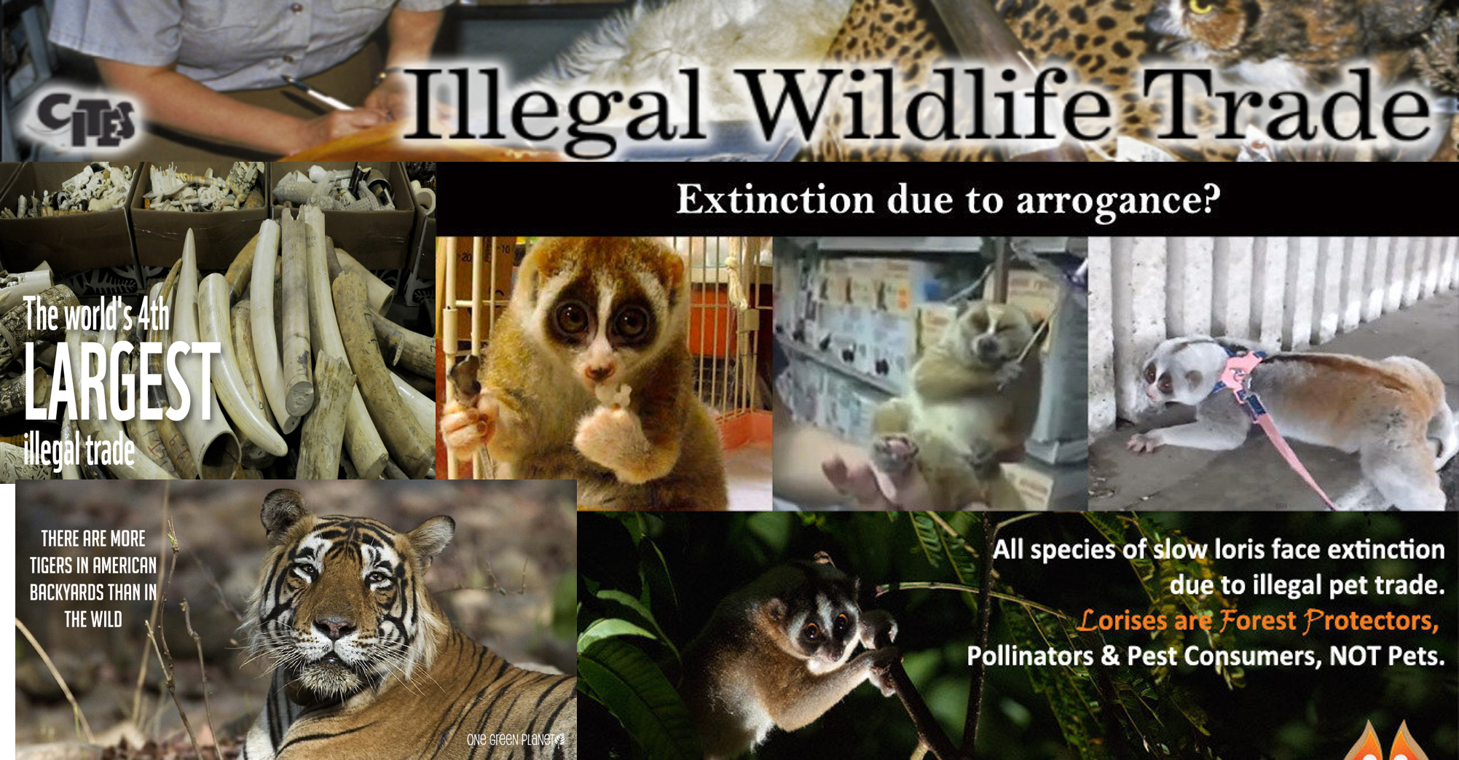

Slide 17
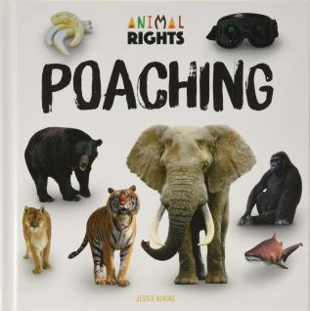
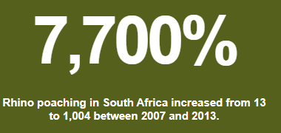
Ivory estimated to weigh more than 23 metric tons—a figure that represents 2,500 elephants—was seized in the 13 largest seizures of illegal ivory in 2011. Poaching threatens the last of our wild tigers that number around 3,890. Wildlife is traded for skins, leather goods or souvenirs; as food or traditional medicine; as pets,etc. Illegal wildlife trade runs the gamut from illegal logging of protected forests to supply the demand for exotic woods, to the illegal fishing of endangered marine life for food Exotic pet trade - The illicit sales of live animals comprises a major part of the overall illegal wildlife trade, a multibillion-dollar global black market. Demand for unique creatures has exploded in recent years, Some exotic pets are bred in captivity. Conservationists often see captive breeding as a way to save wild animals from poaching for the pet trade, and many countries allow for the export of captive-bred animals as long as the proper legal documents are obtained CHINA'S DEMAND FOR EXOTIC PETS BRINGS BUSINESS, AND CONCERN: China has seen a sharp increase in the number of non-traditional exotic pets
The world is dealing with an unprecedented spike in illegal wildlife trade, threatening to overturn decades of conservation gains.
Ref: https://www.nationalgeographic.com/animals/reference/exotic-pet-trade/
https://www.worldwildlife.org/threats/illegal-wildlife-trade

Slide 18
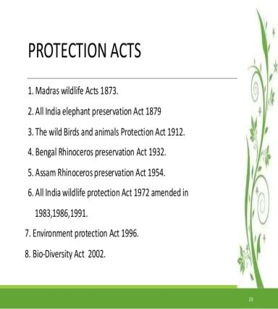
Protection of endangered & endemic species
Protection of endangered species at International level
The Environment Protection and Biodiversity Conservation Act 1999 (EPBC Act) is the Australian Government's principal piece of environment legislation.
US Fish & Wildlife Service, Division of Law Enforcement
Bald and Golden Eagle Protection Act
Migratory Bird Treaty Act
Marine Mammal Protection Act
Endangered Species Act
Antarctic Conservation Act
China - Forest Law, the Law on the Protection of Wildlife, The Environmental Protection Law
The endangered species in India have been identified by different national and international organizations
World Wildlife Fund (WWF),
International Union for Conservation of Nature and Natural Resources (IUCN),
Wildlife institute India (WII)
Protection of wild life under constitution of India
Article 48A (Protection and improvement of environment and safeguarding of forests and wild life)
Article 51- A Fundamental duties- It shall be the duty of every citizen of India - to protect and improve the natural environment including forests, lakes, rivers and wild life, and to have compassion for living creatures
Ref: https://sg.inflibnet.ac.in/bitstream/10603/38074/8/08_chapter%203.pdf

Slide 19
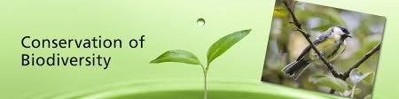
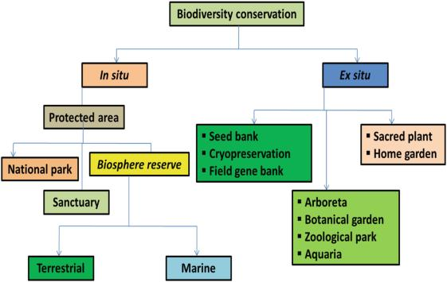
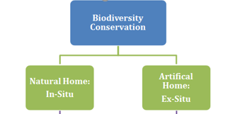
In situ conservation
Conserving a species in its own habitat (national parks and wildlife sanctuaries)
Protect the whole ecosystem, not individual species
Depends on feeding habits of animals such as elephant
In situ conservation: Bandipur, Nagarhole, Periyar, Silent Valley, Eravikulam: Elephant
Coastal ecosystems: Chilka lake (Orissa), Point Calimere (Tamil Nadu), Sunderbans, Andaman & Nicobar Islands

Slide 20
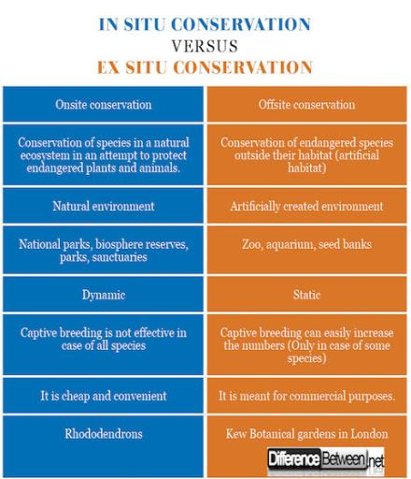
In situ conservation plans – Case studies
Project Tiger
Initiated in 1973 by Govt of India in support with WWF - Initiated in 9 tiger reserves & extended to 23
Appr. 3000 tigers (from 268 in 1972)
Project Crocodile
Initiated in 1975 - Restocking of natural water bodies from crocodile breeding centers for conservation
Project Elephant
Initiated in 1992 – for Asian elephants - Implemented in 16 states
Protect elephants, their habitat & corridors, Welfare of captive elephants
Olive Ridley turtles
Gahirmatha & two other sites in Orissa, Breeding season: December-April
Mass nesting - Largest nesting site in world
Threats: Shrinking nesting sites, Trawler fishing, Roads & other infrastructure development activities.
Conservation efforts: Notified as sanctuary (Bhitarkanika), Prohibition of trawling, Turtle excluder devices, No fishing season: January-May
Ref: http://www.wiienvis.nic.in/Database/ElephantReserves_8226.aspx

Slide 21
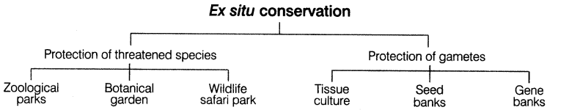
Ex situ conservation
Conserving a species outside its habitat
Botanical gardens & Zoological parks
Breeding as part of conservation in zoos
Case studies
Madras Crocodile Trust Bank: from 10 to 8000 crocodiles. Re-introduction into habitat determines success
Beej bachao Andolan
Conservation of seeds of hundreds of local rice varieties, rajma, pulses, millets, vegetables, spices, herbs
Cryopreservation - Suspending life at sub zero temperatures - - 192⁰C
Germplasm storage
Seeds, Apical meristems / callus
Microbes, DNA

Slide 22


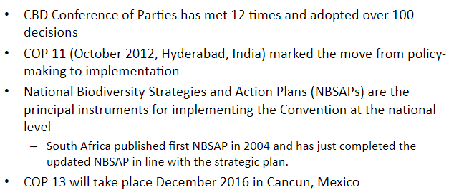
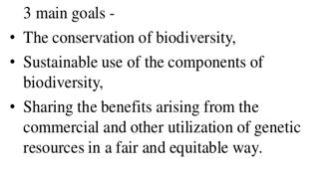
Ref: https://www.cbd.int/

Slide 23
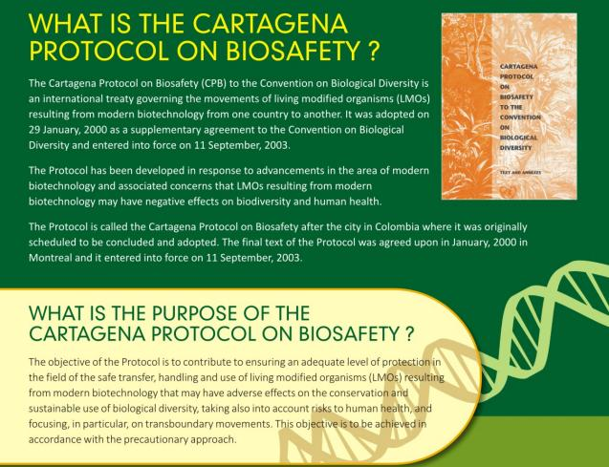
Cartagena protocol on biosafety to the convention on biological diversity
Ref: http://www.geacindia.gov.in/resource-documents/13_1-Cartagena_Protocol_on_Biosafety_An_Overview.pdf

Slide 24
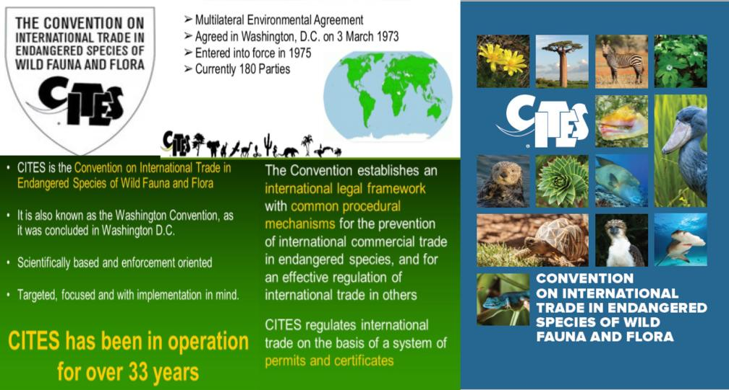
https://www.cites.org/

Slide 25

India signatory to…
World heritage convention
Biodiversity rich areas in India recognized as – protected areas – “World Heritage Sites”
Great Himalayan National Park Conservation Area (2014)
Kaziranga National Park (1985)
Keoladeo National Park (1985)
Manas Wildlife Sanctuary (1985)
Nanda Devi and Valley of Flowers National Parks (1988,2005)
Sundarbans National Park (1987)
Western Ghats (2012)
Ref: http://whc.unesco.org/en/statesparties/IN

